Slide 1
Overview of Finite Difference Methods for Groundwater Flow

Slide 2
Simple Flow System
R
Lake
Stage = H₀
Stage = H_{L}
Lake
Lake
Alluvial Aquifer
Lake
A
B
A
B
R
Lake
Lake
Lake
1-D Horizontal Flow
Lake
x = 0
x = L

Slide 3
1-Dimensional Steady-State Horizontal Flow with Areal Recharge: Fixed head Boundaries
Boundary conditions
Where:
is thickness
R
is hydraulic conductivity
1-D Horizontal Flow
Lake
is distance
is Recharge
x = 0
x = L
is hydraulic head
Stage = H₀ = 10
Stage =H_{L} = 5
is length of the system (e.g. rightmost coordinate)

Slide 4
Slightly More Complex Example Flow System
R
Stage = H
Lake
Alluvial Aquifer
Lake
A
B
A
B
R
Lake
1-D Horizontal Flow
Lake
x = 0
x = L

Slide 5
1-Dimensional Steady-State Horizontal Flow with Areal Recharge: No flow and fixed head
Boundary conditions
R
Where:
is thickness
is hydraulic conductivity
1-D Horizontal Flow
Lake
is distance
is Recharge
x = 0
x = L
Flux = 0
Stage =H_{L} = 5
is hydraulic head
is length of the system (e.g. rightmost coordinate)

Slide 6
Finite-Difference Representation

Slide 7
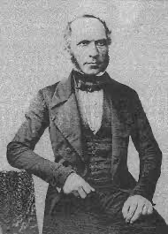
Water Balance for the Interior Cells
Applying Darcy’s Law
Water balance

Slide 8

General Finite-Difference Equation
Group terms and define “conductance”
…through the magic of algebra (thanks Al-Khwarizmi!)
Al-Khwarizmi

Slide 9
Conductance: what about Heterogeneity?
Need to calculate a mean hydraulic conductivity.
Harmonic Mean is a popular choice
So, conductance between cells and is:

Slide 10
We can summarize all this a bit to make the symbology a little more chill to work with
Make a few definitions:
Then we can restate the interior cells formula:

Slide 11
Simple Boundary Conditions
R
R
1-D Horizontal Flow
1-D Horizontal Flow
Lake
Lake
No-flow left boundary:
x = 0
x = L
x = 0
x = L
Fixed head boundary. Just
set the head to a set value
Using a little algebra again and
rearranging water balance with Darcy’s Law:

Slide 12
System of Equations: lakes on both left and right sides

Slide 13
System of Equations: no-flow left boundary and a lake on the right side

Slide 14
How do we solve these???
We have to find a set of head values that satisfy all the equations at the same time. How???
Explicit methods – we can start with a candidate of head values, then loop through the nodes, applying the equations. This will be wrong at first, but upon repeated loops (iterations) we can converge on a solution
Implicit Methods – for cases like this one, we can just ”invert the matrix”
In reality, this matrix inversion is impractical, but iterative matrix solutions are available

Slide 15
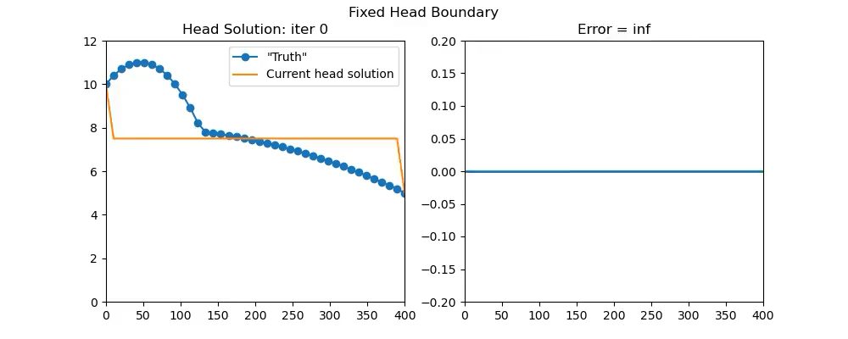
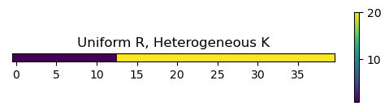
Solution for lakes on both left and right sides

Slide 16
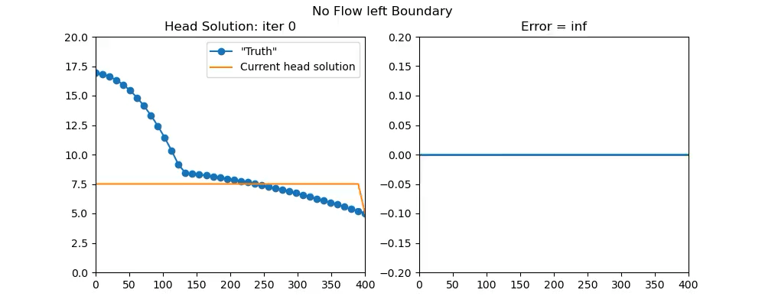
Solution for no-flow left boundary and a lake on the right side

Slide 17
Transient Flow – First Recall The Steady-State Water Balance
Boundary conditions
Where:
is thickness
is hydraulic conductivity
is distance
is Recharge
is hydraulic head
is length of the system (e.g. rightmost coordinate)

Slide 18
Transient Flow – Now add a time dimension
Boundary and initial conditions
now required
Where:
is thickness
is storativity
is hydraulic conductivity
is time
is distance
is Recharge
is hydraulic head
is length of the system (e.g. rightmost coordinate)

Slide 19
Transient Flow

Slide 20

Transient Flow in Finite Differences
Now rearranging and grouping some terms together

Slide 21
Recall this from earlier….
Make a few definitions:
Then we can restate the interior cells formula:

Slide 22
How do we solve these transient equations???
The structure is the same as the steady-state case (think progressive “steady states” as each time marches forward)
In addition to boundary conditions we also have initial conditions (like boundaries in the time dimension)
Each time starts with the solution from the previous time

